Slide 1
SIS Football Analytics Challenge
By: Ryan Baranowski and Bryce Westen

Slide 2
Purpose
Answer the following questions:
Which is the most valuable defensive line position?
What is the nature of the distribution of talent between said positions?
In which in-game or roster construction scenarios would the answer to Question 1 change?

Slide 3
Classifying Defensive Positions
For the purpose of this competition, we will classify defensive positions as follows:
Nose Tackle (NT)
Techniques: 0, 1
Defensive Tackle (DT)
Techniques: 2i, 2, 3
Defensive End (DE)
Techniques: 4i, 4, 5
Edge (ED)
Techniques: 7, 6, 9, on ball linebacker

Slide 4
Methodology
Differentiate between pass and rush plays
Pass plays given more weight due to higher expected EPA
Pressure and tackles lower EPA for passes and runs respectively
Pass plays:
Determine value of pressures by position
Find pressure rates by position
Random Forest: Position pressure importance & predict EPA for positional pressure given down and distance
Rush plays
Determine value of tackle by position
Find tackle rates by position
Random Forest: Position tackle importance & predict EPA for positional tackle given down and distance

Slide 5
Results Overview
Most important defensive line positions in order: Edge, DT, DE, NT
Edge & DT pressures are most valuable (lower EPA most)
Edge & DE pressure at the highest rate, DT not far behind
Outside runs produce highest EPA (the only positive run direction) so edge tackles are more important
Talent Distribution: Invest in Edge and DT
The pressure rates of Edge and DT are skewed right: talent outliers that impact pass game most
Edge that can get pressure and tackle on runs are most valuable
Talent distribution in run game is unclear due to small sample size
Different in-game scenarios
On predictable passing plays (longer ToGo) Edge pressure lowers EPA consistently
On unpredictable pass plays (short ToGo) DE pressure very valuable lower EPA
In obvious passing situations, DT’s impact the run the most

Slide 6
Exploring the Value of Run vs. Pass
When exploring 2019 data provided by NFLFastR:
Team’s passed more than they ran
Team’s were more efficient when the passed
More weight will be put on positions which negatively affect an offense’s pass game
Play Type | # of Plays | % of Plays | EPA Per Play
Pass | 19,827 | 60.8% | 0.042
Run | 12,770 | 39.2% | -0.068

Slide 7
Defending the Pass
Sacks and Pressures have a large impact on passing plays
Effect of Pressures and Sacks (weeks 9-17 in 2019)
Type of Play | EPA Per Play
No Pressure or Sack | 0.206
Pressure on Play | -0.405
Sack on Play | -1.71

Slide 8
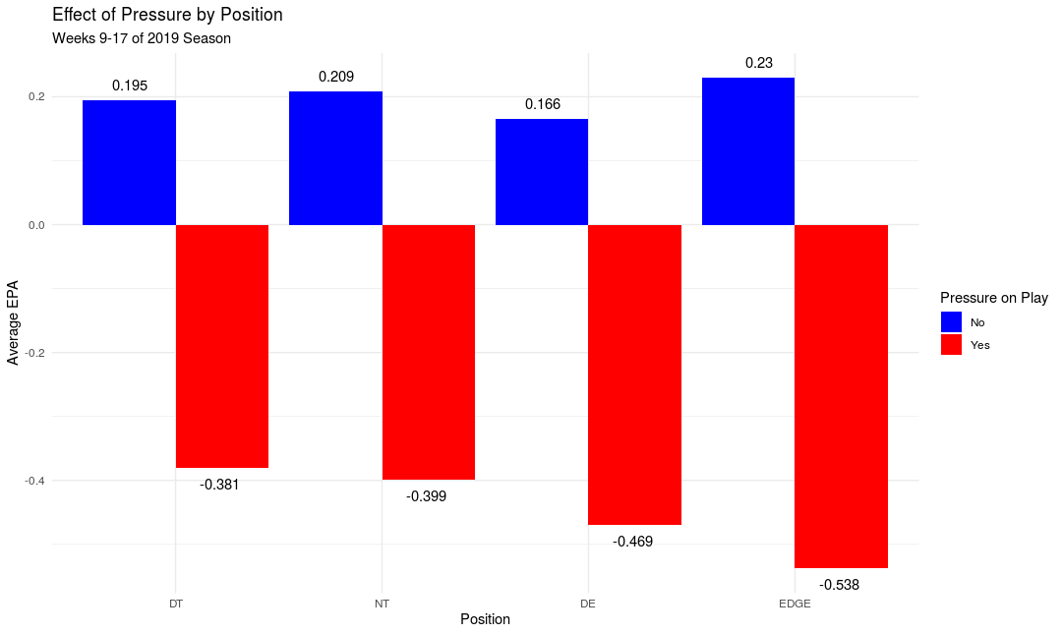

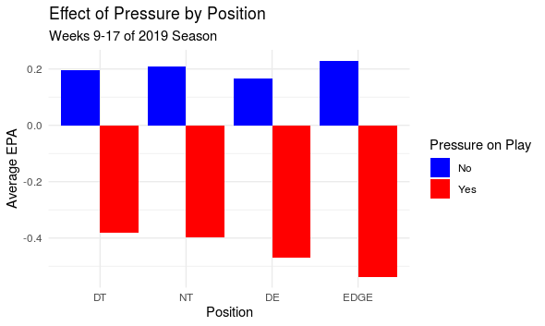
Defending the Pass
Defensive ends and edge defenders make the largest impact when recording a pressure
There is little difference between the impact of pressures from defensive tackles and nose tackles

Slide 9
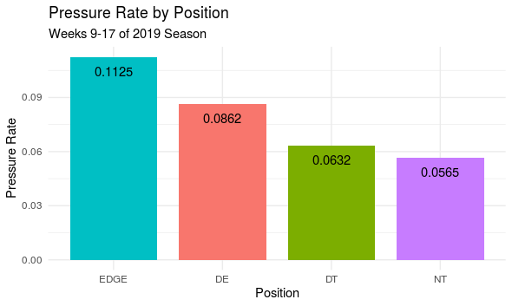
Defending the Pass
Pressure rate increases as you move further from the ball
Edge defenders and defensive ends create significantly more pressure than interior lineman

Slide 10
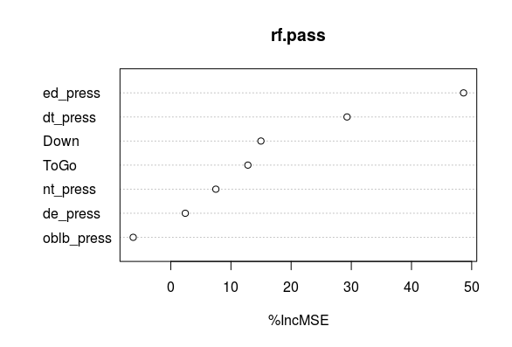
Determining Value of D-Line Positions
Use Random Forest to predict EPA on pass plays based on Down, Distance, and Pressure from each DL position.
Based on variable importance ED and DT are most important

Slide 11
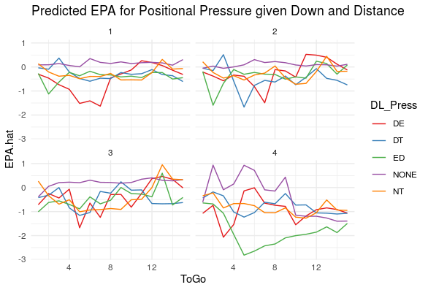
Edge pressure lowers EPA consistently (especially on 4th), DE critical on short distance (not on long though)

Slide 12
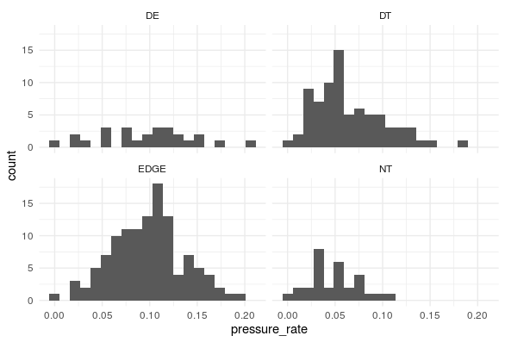
Talent Distribution
Edge and DT skewed right
Important to invest in right tail pressure talent
DE and NT have relatively even talent distribution by pressure rate

Slide 13
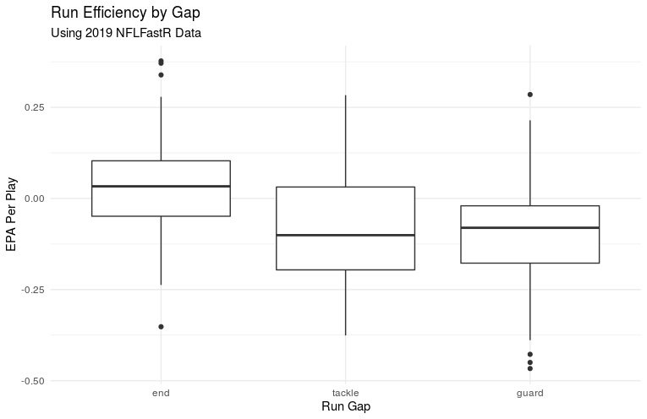
Defending the Run
Running the ball becomes more efficient as the gap moves further from the center
Therefore, positions which can protect the “edge” of the defense may be more valuable

Slide 14
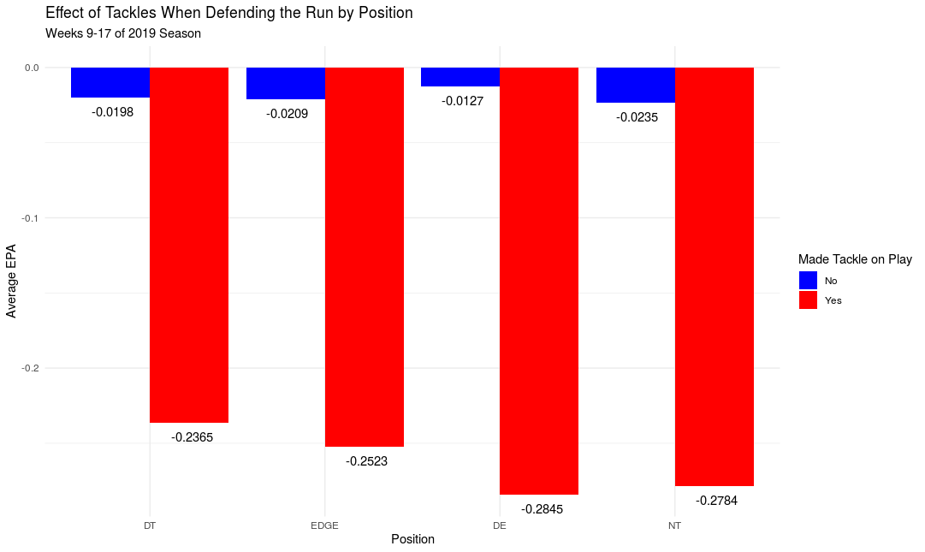
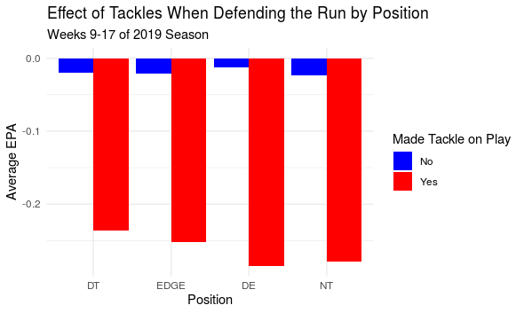
Defending the Run
Nose tackles and defensive ends impact EPA the most when they record a tackle on a run play
However, the overall impact on EPA between positions is not material

Slide 15
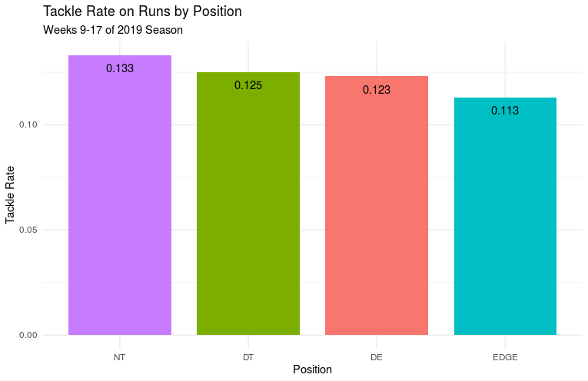
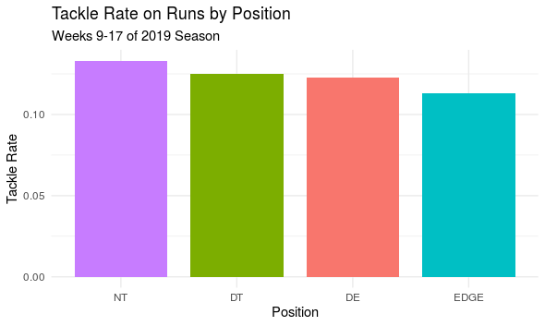
Defending the Run
Tackle rate by position decreases as you move further away from the ball
While interior lineman have higher tackle rates, the difference between positions is relatively minimal

Slide 16
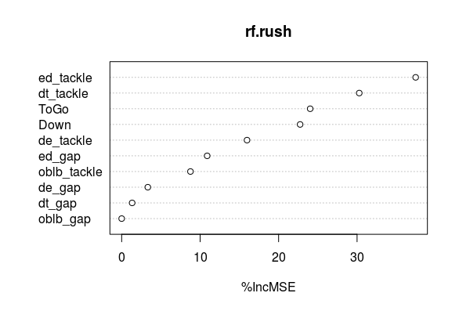
D-Line Value on Runs
Use Random Forest to predict EPA on rush plays based on Down, Distance, gap, and tackle from each DL position.
Based on variable importance ED and DT are most important

Slide 17
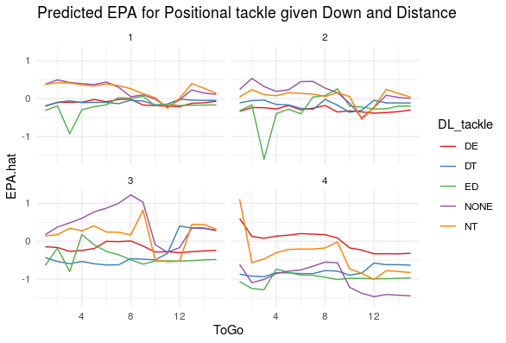
Edge tackles consistently lower EPA, especially short ToGo; DT especially important on 3rd and short
Note: this is on run plays directed at each positions’ gap

Slide 18
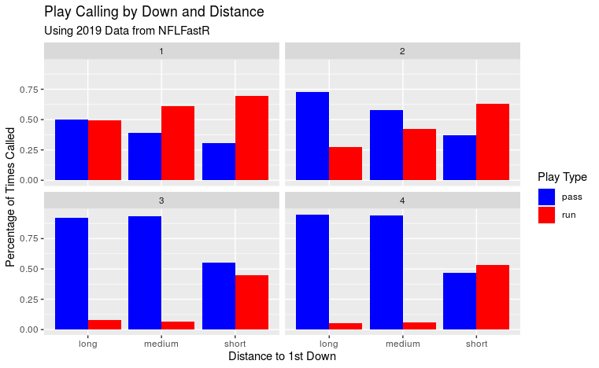
Different Scenarios
In 2019, NFL offenses ran more often on early down and short distance opportunities as well as 4th and short
Based on predicted EPA on passing downs in these situations, DE’s were the most impactful when they recorded a pressure
Conversely, on obvious passing downs the predicted EPA when an offense ran the ball was most impacted when DT’s recorded a tackle

Slide 19
Conclusions
Most important defensive line positions in order: Edge, DT, DE, NT
According to random forest analysis, edge pressures and tackles have the largest impact
DT’s come in second in random forest pass and run analyses
NT’s consistently had the lowest impact
Talent Distribution: Invest in Edge and DT
The pressure rates of Edge and DT are skewed right: talent outliers that impact pass game most
DE’s and NT’s have relatively even talent distribution by pressure rate
Talent distribution in run game is unclear due to small sample size
Different in-game scenarios
In general, few in-game scenarios changed answer to Q-1
On predictable passing plays (longer ToGo) Edge pressure lowers EPA consistently
On unpredictable pass plays (short ToGo) DE pressure very valuable lower EPA
In obvious passing situations, DT’s impact the run the most

Slide 20
Limitations and Future Analysis
Limitations
Small Sample Size
Tackle rates by run gap too small to evaluate
Unable to determine year-to-year correlation of pressure and tackle rates
Future Analysis
Compare value of all positions
Have written several papers on this specific subject
Concluded that lineman are least important defensive position
Secondary players drive defensive production
Control for coverage when analyzing defensive line impact
Analyze what drives pressures
Time to throw

